Slide 1


Data Challenge
Time Series Data Handling
Submitted by:
Muhammad Aaqib Illyas

Slide 2
Challenge Description
Machine produces a certain output and it is updated the with the latest IoT device available on the market. The IoT device comes with 3 different sensors to track machine health: temperature sensor, pressure sensor, and water level sensor. Machine status is tracked automatically by the machine considering 4 modes: Running/ Idle/ Off/ Failure. Data transmission is at a frequency of 1 minute.
Tasks Performed
Random Sensors Data generation
Addition of Data Transmission Issues
Observation of Machine status
Building a Model to predict Machine status
Evaluation of Model
Ideas about the Optimization of Machine Efficiency

Slide 3
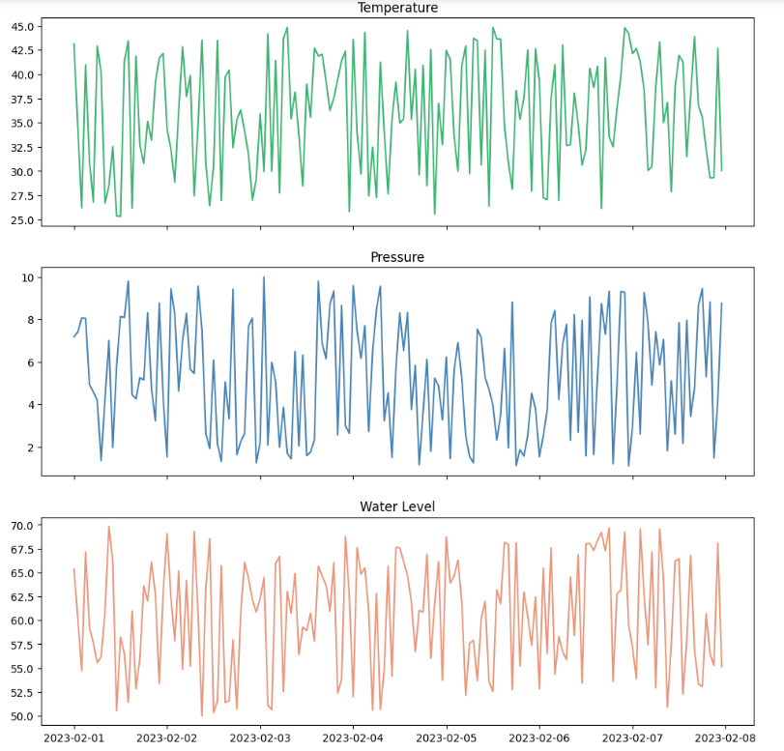
Visualizations of Generated Data

Slide 4
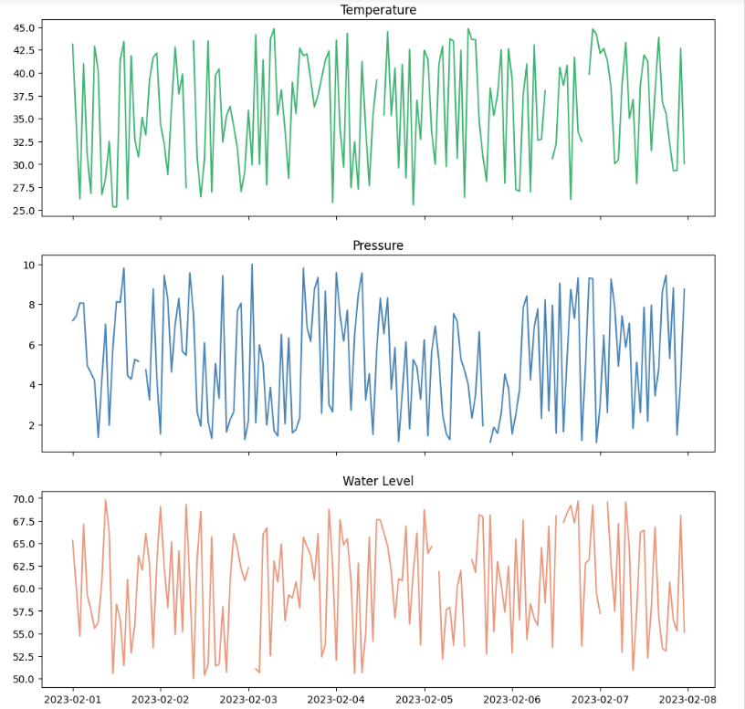
Measured Data with missing Values

Slide 5
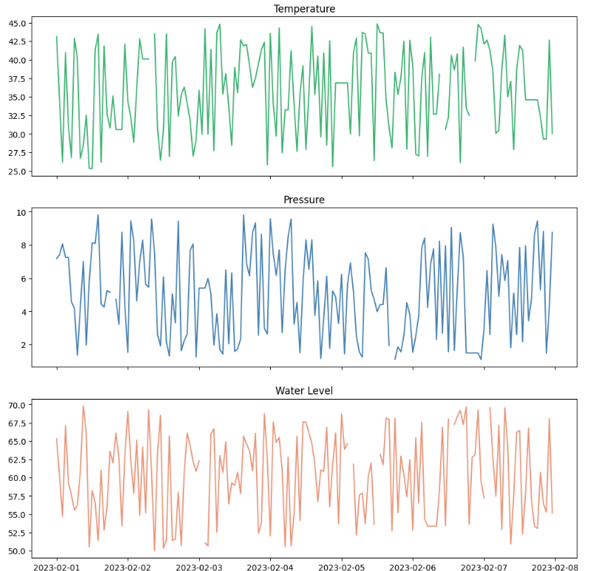
Measured Data with Missing & Static Values

Slide 6
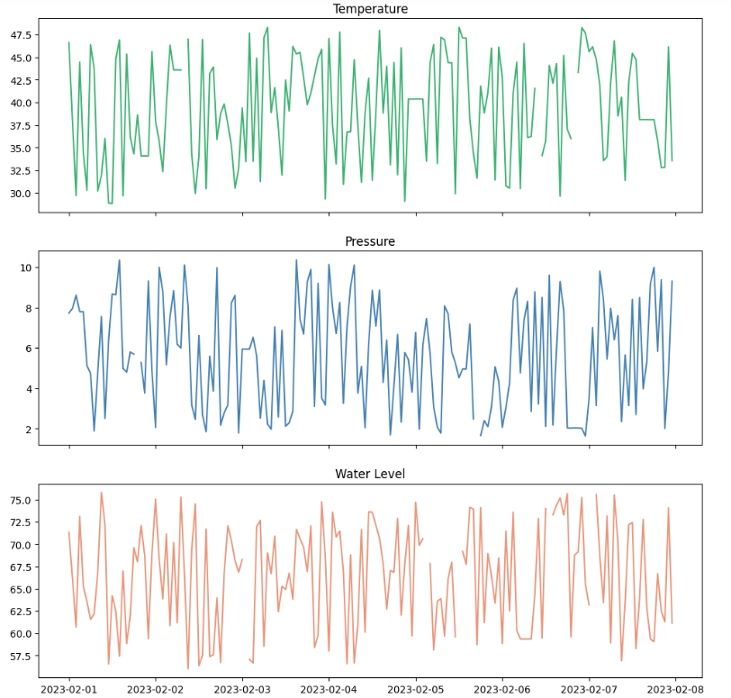
Addition of Noise

Slide 7
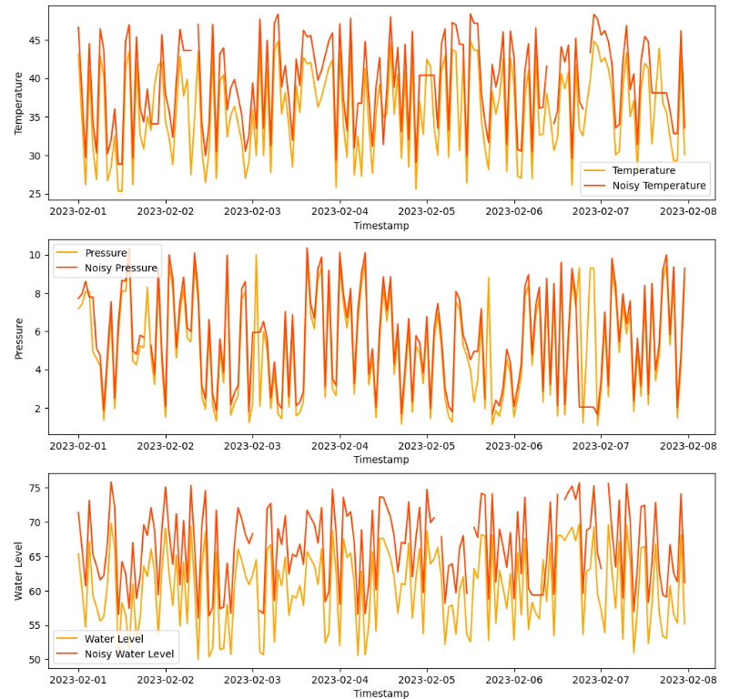
Comparison (Data after Transmission Issues and before)

Slide 8
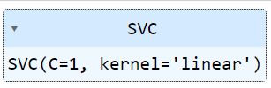
Support Vector Machine (SVM) model
The SVM model is used for to predict the Machine status “Failure” from this categorical dataset.
Predictors and Target variable
The 'Temperature', 'Pressure' and 'Water level' measurements are taken as predictors and 'Machine status' is the target variable.
To predict the "Failure" status only, it is classified as '1' and the other states (Running, Idle, Off) as '0'.
The NA values are also dropped because SVM model can not handle the missing values.
“Support Vector Machine”
Model

Slide 9
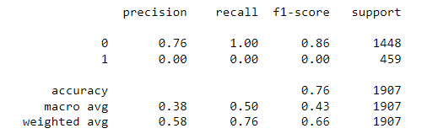
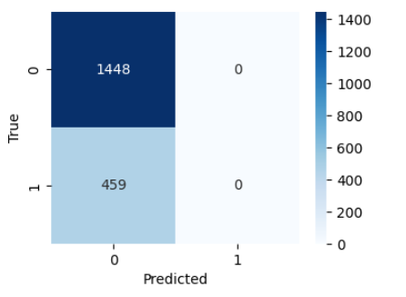
Classification Report
Model Evaluation
Confusion Matrix

Slide 10


